Slide 1
BIG DATA and Mathematics for the Future
MateITALY
Venezia, Università ca’ Foscari, Aprile 2018
Emanuele Borgonovo
Bocconi University and AMASES
Director Bachelor in Economics, Management and Computer Science
Co-Editor in Chief, European Journal of Operational Research

Slide 2

DATA SCIENCE
Digitalization
Globalization and increased connectivity make available to citizens, to corporations and scientists an amount of data unthinkable a few years ago
We are at the verge of the data driven economy
We register a large increase in the use of computers in everyday life, with new societal phenomena, entrepreneurial opportunities and new professions
http://www.webpagefx.com/internet-real-time/

Slide 3

Prevasiveness
DATA SCIENCE
People
Internet
Devices
DATA
Algorithm
Marketing
Digitalization
Business (Industry 4.0)
Public Institutions
Cloud
Healthcare
Social Relations

Slide 4
Communication EC-European Parliament
July 2 2014
Several players to create added value from the availability of big data
EC document on cloud computing: big data and correlated services will reach 16,9 billion USD value in 2015, with an average growth rate of 40%, seven times higher the rate of growth of technology market
In the UK number of big data specialists working in big firms will increase by 240% (Source: SAS report)
EU Grand Colation for Digital Jobs

Slide 5
EU Document
An adequate skills base: The competence base addresses descriptive and predictive data analytics, data visualisation, artificial intelligence and decision-making software tools and algorithms.
The EU document encourages close cooperation between players (i.e., industry and universities) to achieve the sharing of the desired competences
The training of professionals who can perform in-depth thematic analysis, exploit machine findings, derive insight from data and use them for improved decision-making is considered crucial.

Slide 6
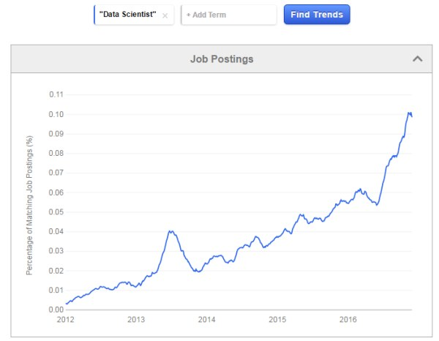
New Professions and New Skills
D.J. Patil nominated in February 2015
first White House chief data officer
But Mike Powell chief Data officer NYC
Italy: Diego Piacentini (Amazon) Digital
Science group for the Italian Digital
Agenda

Slide 7
New Programs Nationally and Internationally
Internationally: many (thousands) of MSc’s and BSc.
MIT, The Infinite: “Two Sciences tie the knot” to announce a new major in Computer Science and Economics
Italy (source: bachelorportal.eu)
  Bachelor Level: a few programs (Bocconi, Milan; Bologna)
  MSc: 11 programs (source: MastersPortal.eu): Bologna, Genova, Milan (Bocconi, Bicocca, Cattolica, Statale), Roma (Luiss, Tor Vergata, Sapienza), Padova, Torino

Slide 9
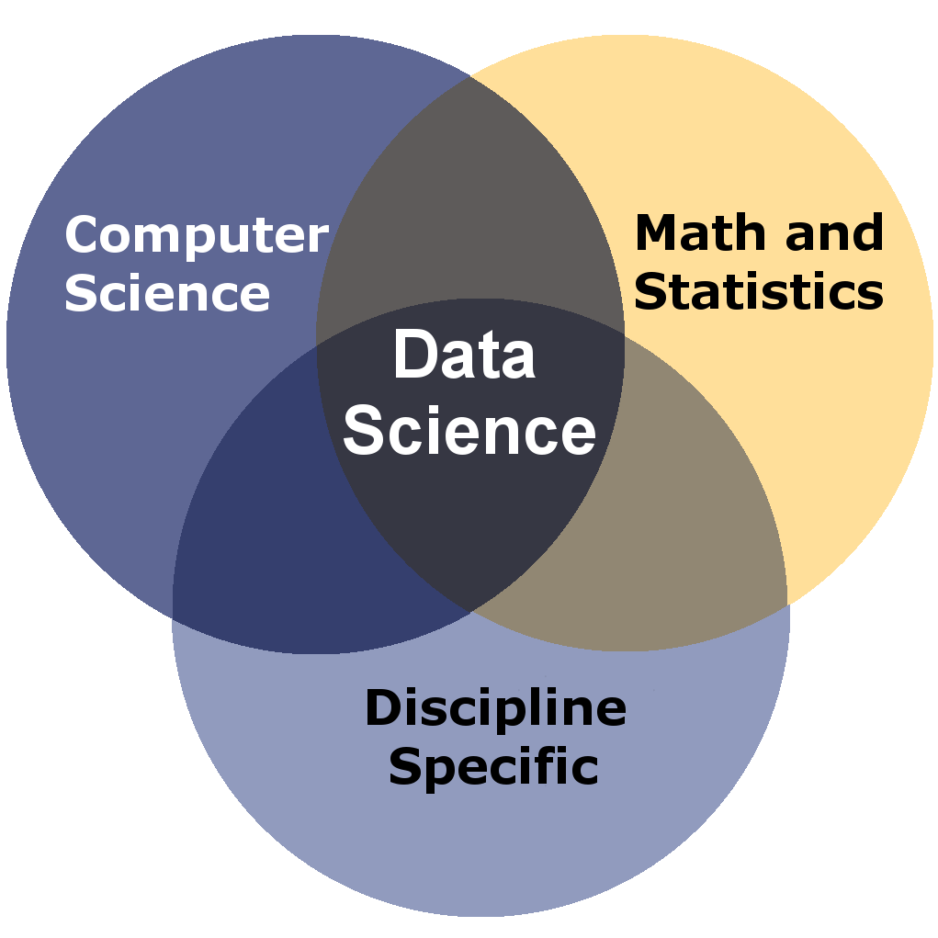
Pillars
DATA SCIENCE
Data science has three pillars: Mathematics, Statistics and Computer Science. It addresses challenging issues in a variety of applied fields by analyzing large-scale datasets and modeling the underlying complex phenomena.

Slide 10
What is Big Data?
Big Data is high-volume, high-velocity and high-variety information assets that demand cost-effective, innovative forms of information processing for enhanced insight and decision making (Source: Gartner)
the technical skills to gather and manage data
the ability to interpret data through the lens of economic models, thus enabling them to provide credible support to company decision making.

Slide 11
Computer Science
Large Data Storage and Retreival
Memory Requirements
Parallel and Cloud Computing
… an example…

Slide 12
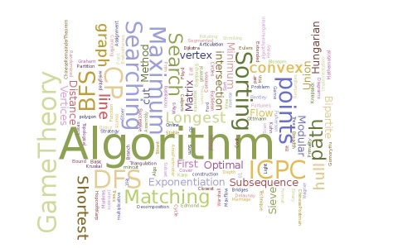
Algorithms
Click Here

Slide 14
Machine Learning: Algorithms
Supervised Learning
  The dataset is divided into training and testing
Unsupervised Learning
  The data are not prepared or labelled, the algorithm learns by similarity
Semi Supervised Learning

Slide 15
Types of Algorithms… (if a list is possible...)
Regression and Regularization Algorithms
Instance-based algorithms
Decision Trees
Bayesian Networks
Neural Networks
Deep Learning
… more

Slide 17
Some most Recent Examples
AI in optimization
  A. Lodi, Y. Banjo, E. Frejinger (Montreal)
  Using AI to help solve complex optimization problems
  Helps in Mixed Integer-Linear programs
  Helps in Integer programs improving branch and bound
Making Simulations More Efficient
  Borgonovo, E., Lu, X. Rosasco A., Rudi A.
  Fast kriging
Bayesian Classifier for Preference Learning
  Select your best camera
  Multicriteria problem
  Bayesian Approach: set a prior over a class of uncertain parameters of the algorithm
  Computer Implementation

Slide 18
Challenges
Research for reducing memory requirements
In statistics, for instance, large datasets: how can we estimate the same quantities in a reasonable time?
Or how can we protect privacy in our “mathematical formulae”?
Solving Large Scale Optimization Problems

Slide 19
Large Donations
MIT-IBM Watson lab 240MUSD (Sept. 2017)
Accenture-MIT
Several Private or Publicly Funded Chairs
Facebook Research (Yann Le Cun)
Microsoft Research (Ed Horvitz)
Google Research (Peter Norvig)

Slide 20
Business Impact: Industry 4.0
Increase automation
Self Driving Cars
Machines that communicate to machines

Slide 21
Modern Decision Making Process
Real World
Intuition
Decision
Problem
Decision
Payoff
Interpretation
Abstraction
Analysis
Model
Results

Slide 22
Social Impact
New jobs for young generations?
What about the intermediate generation?
Need for additional education?
How does society perceives AI?

Slide 23
Algorithms (models) can fail
Google Flue successfully predicted flue diffusion in the US for 4 years
At year 5 unsuccessful predictions due to overfitting

Slide 24
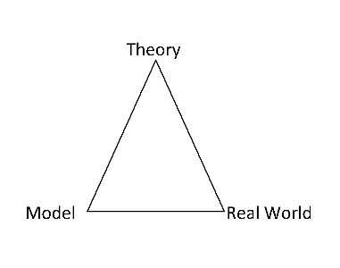
Epistemologically, what are we doing?
DATA

Slide 25
Scientific Challenges
New Problems -> New Concepts -> New Algorithms
Old Problems -> New Challenges -> New Algorithms
Make Everything Fast and Large
Investigate the profound meaning of what we are doing (let us not loose sight on the meaning)
Causality, what is it?
Interactions, what are they?
Statistical dependence, what do we mean by it?

Slide 26
Training a Neural Network in Matlab
We try here and train our own network for prediction.
Suppose your variable of interest is the production of a given item. The production process is a function of three variables: the «geography» (the season, country, provider), quality of the supply, the reliability of the plant (number of planned and unplanned outages).
You have collected data for these plants at a number of facilities. You have also rescaled the data on [0,1] (what you see is, in fact, an artificial dataset). Recall our goal is to train the network.

Slide 27
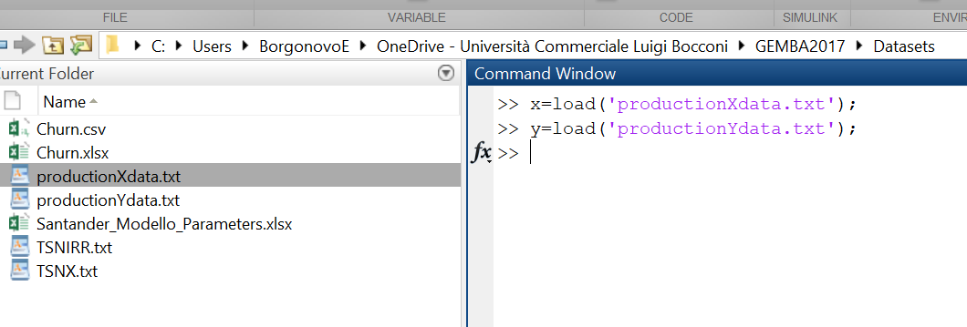
Load the Dataset

Slide 28
Let us give a look at the data
ksdensity(y)

Slide 29
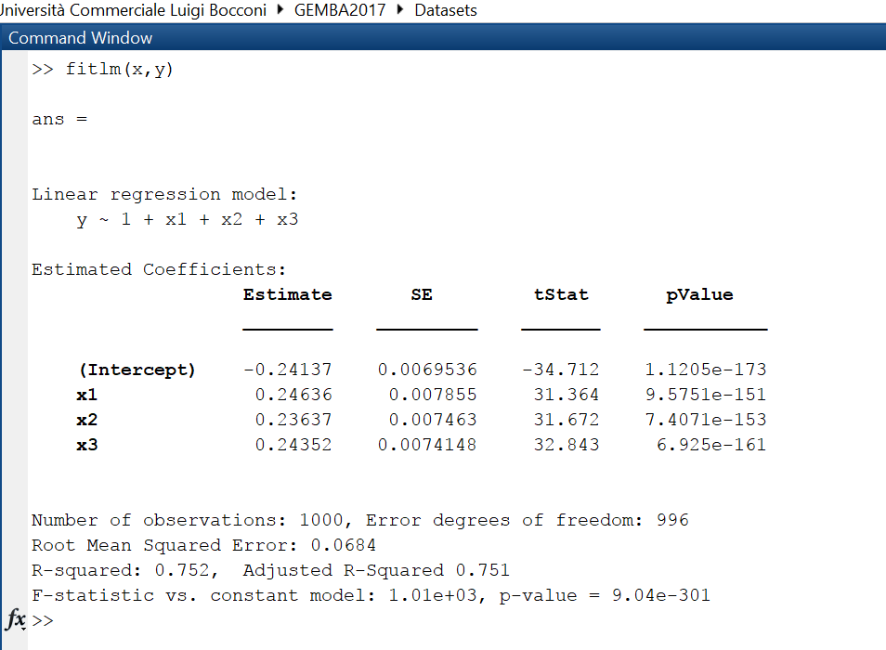
Fitting a Linear Regression

Slide 30
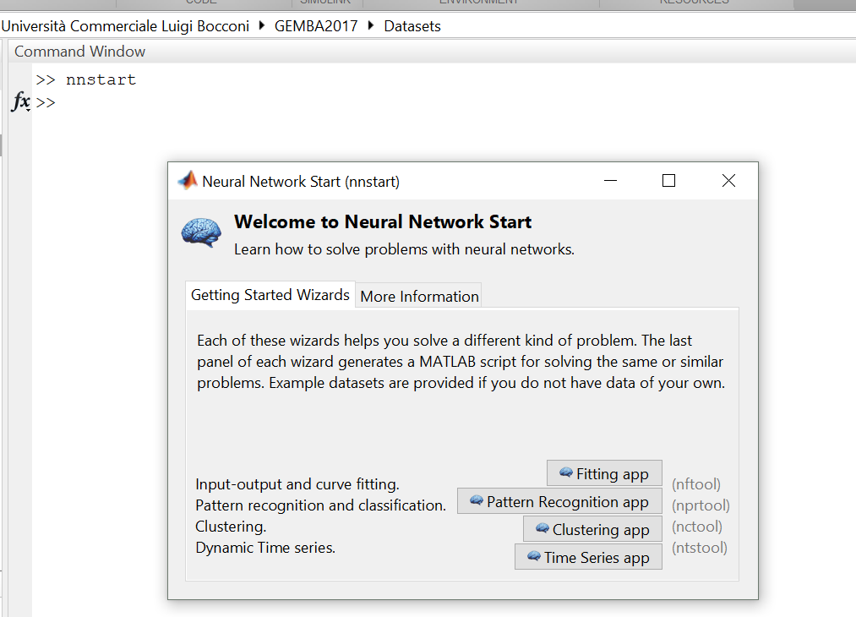
Fitting a Neural Network

Slide 31
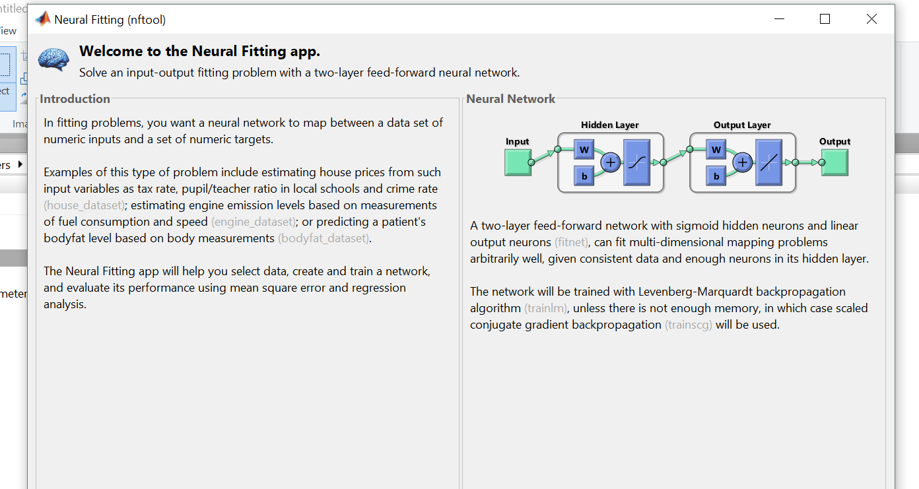
First screen

Slide 32
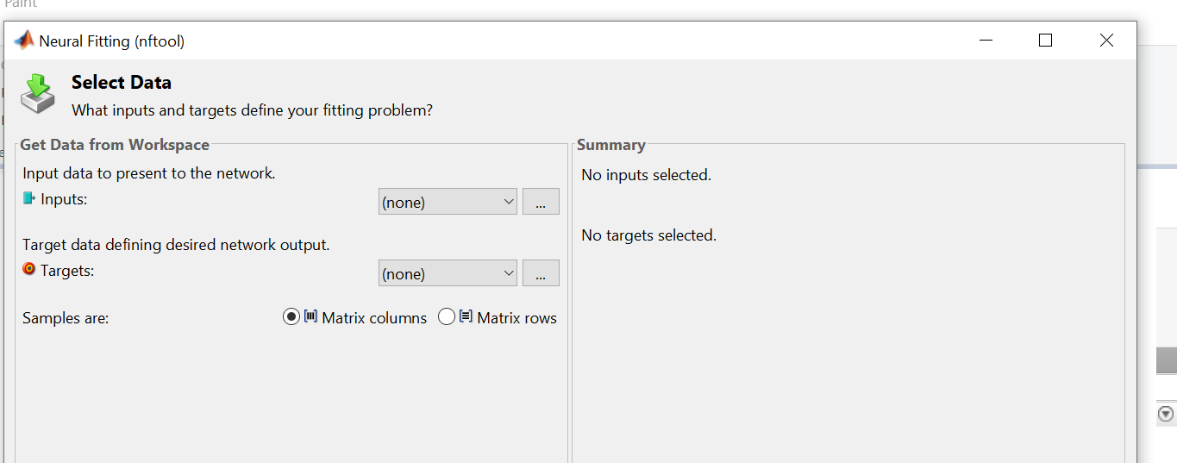
Import data menu

Slide 33
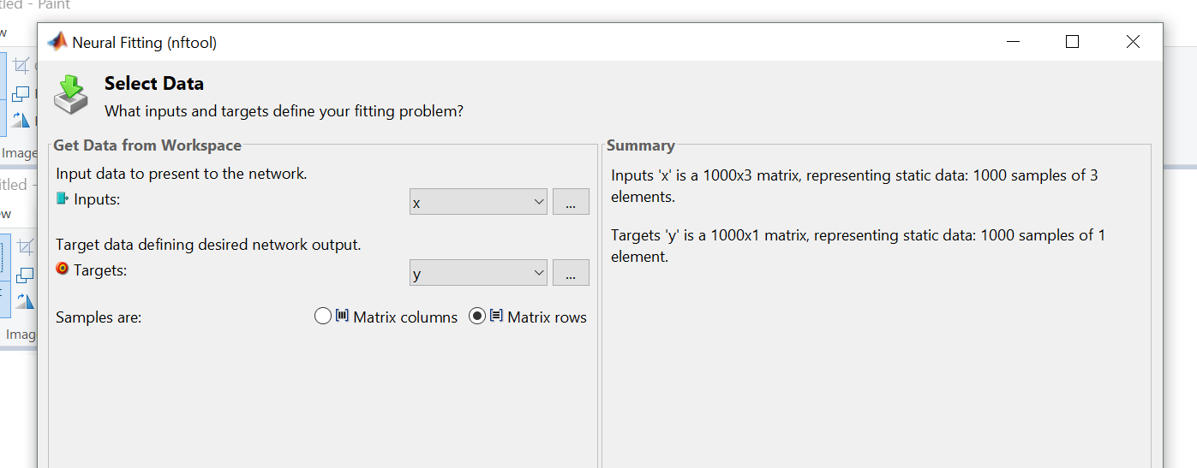
Import x and y
Click Next at the bottom left of the page

Slide 34
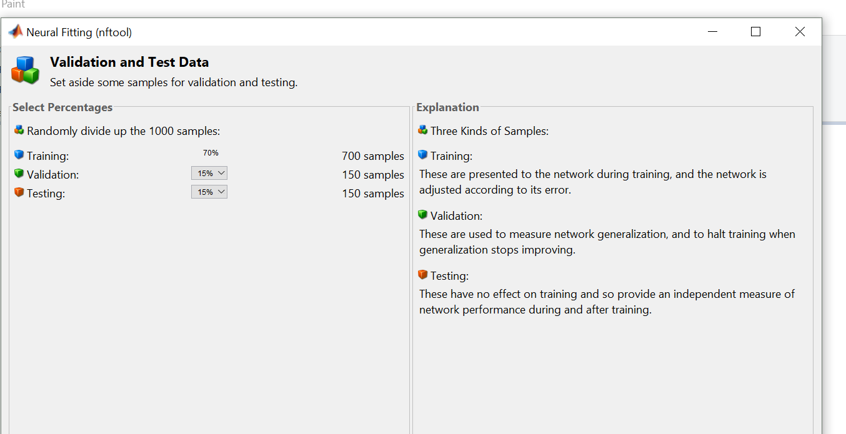
Train the Network

Slide 35
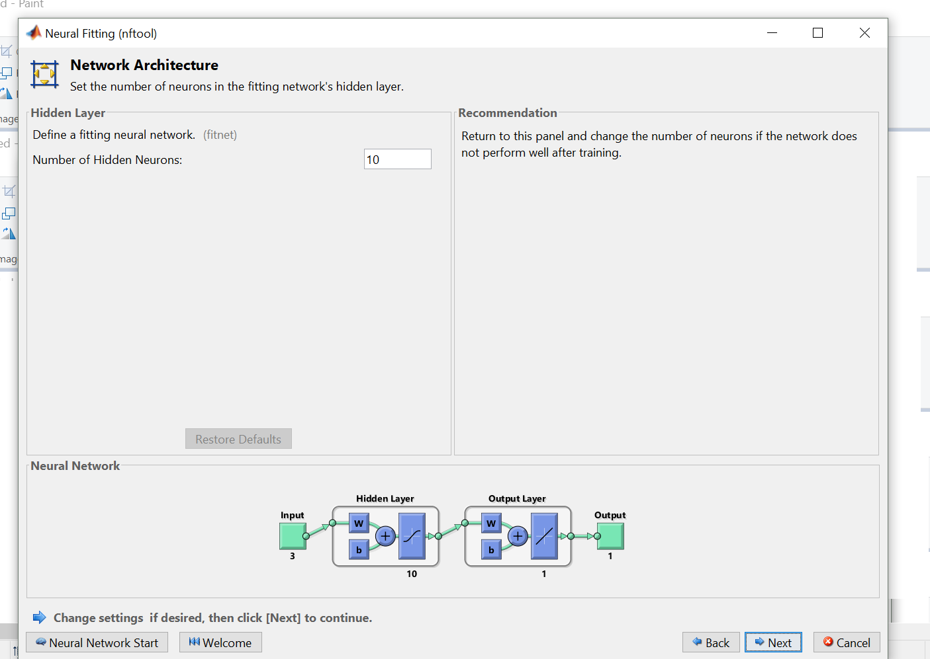
Network Structure

Slide 37
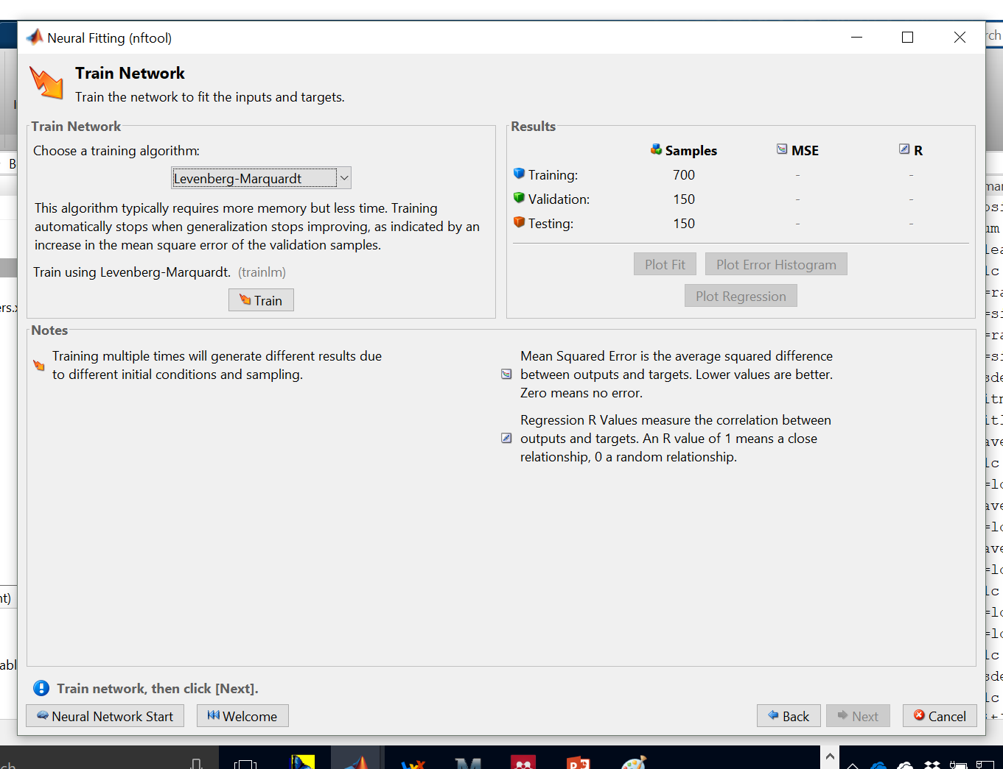
Training

Slide 38
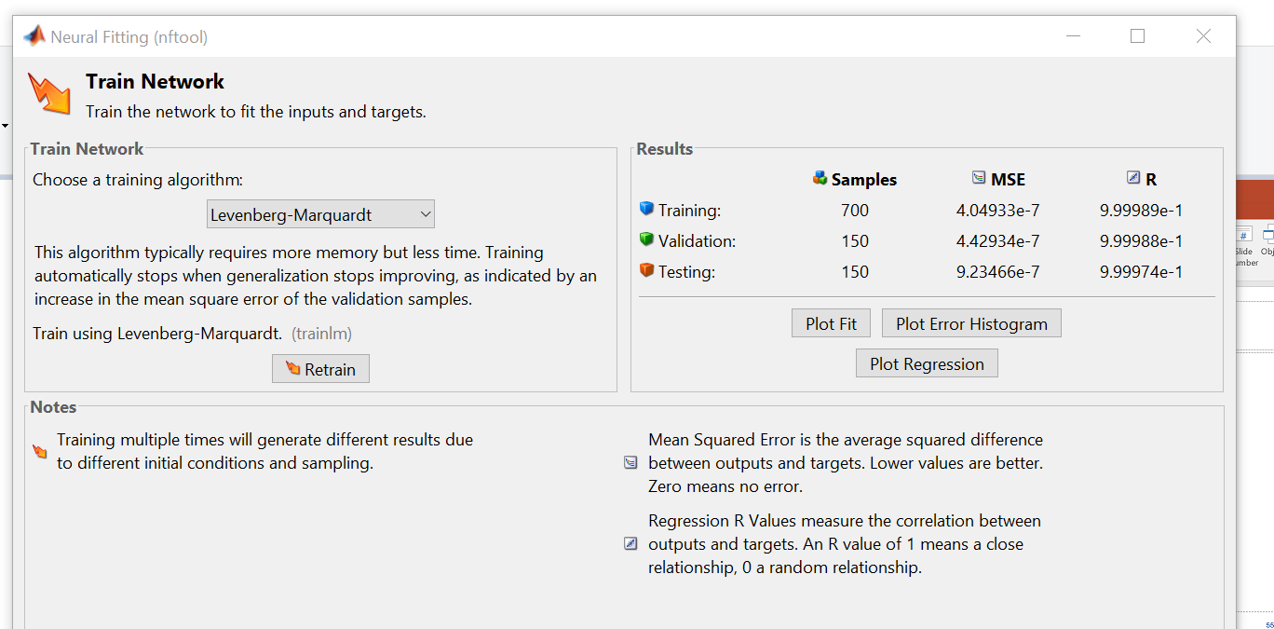
Reading Training Results

Slide 39
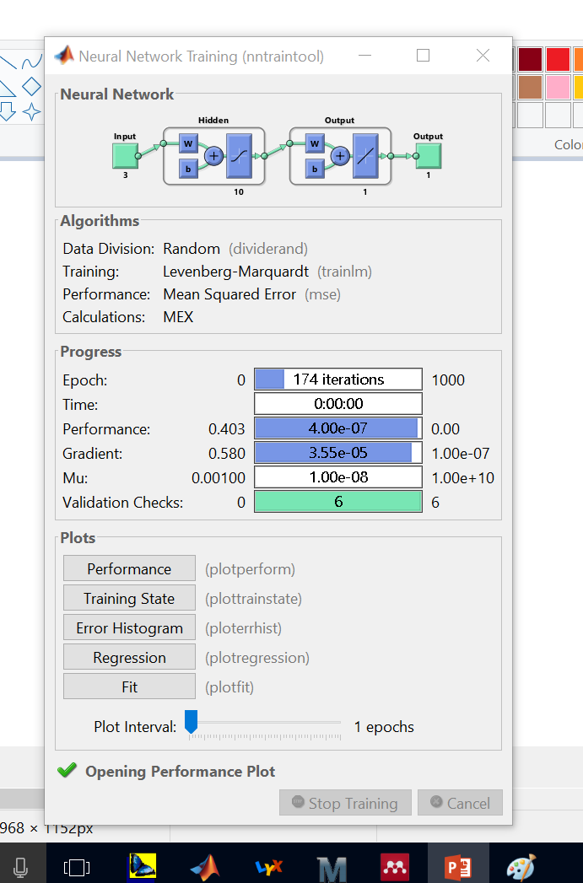

Slide 40
RMSE Plot

Slide 42
Error Historam

Slide 44
Regression Fit (R)

Slide 45
Discussion
Advantages: does not require linear expression
Very powerful
Disadvantage: black box

Slide 46
Applications
Forecasting demand for bike sharing
Car Sharing Demand

Slide 47
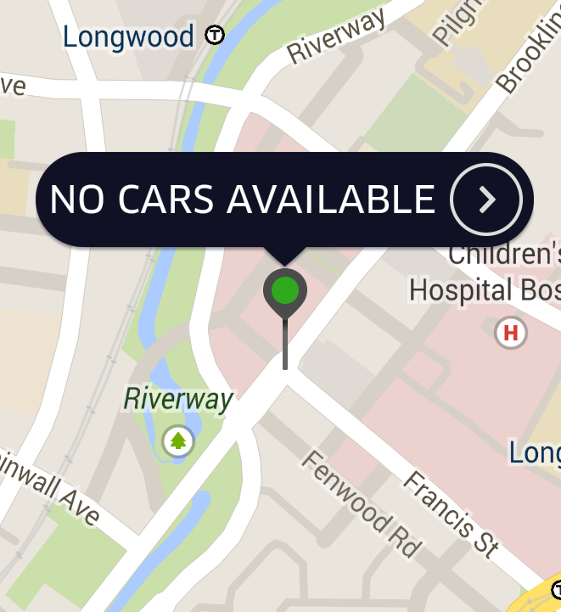
Using Deep Learning to forecast the demand for car sharing:
Milan case study
From Master of Science Thesis of Matteo Zunino, Bocconi University. Supervisors: E. Borgonovo and A. Rezzani

Slide 48
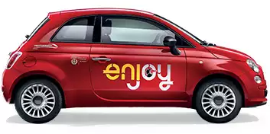

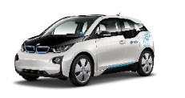
Car sharing: market overview*
Figure 1: car sharing market revenues and users worldwide
Revenues (€ mil) ⁴
Users (mil) ⁴
Urbanization is putting pressure on city governments to increase incentives for environmentally sustainable mobility services and reduce traffic congestion in big cities. The emergence of new innovative mobility services will ultimately lead to the disappearance of private car ownership in big cities in the future ¹.
One of the most successful forms of shared-mobility services is car sharing (CS). Car sharing is an innovative mobility service in which a car sharing operator (CSO) provides individuals and/or companies with the access to a fleet of vehicles on an as-needed basis through membership programs, without the cost and responsibilities associated with car ownership ².
Car sharing services can be categorized in two main clusters: 1) Two-way car sharing, in which users have to return the car in the place where it was originally accessed;
2) One-way car sharing, in which users are allowed to return cars in a different parking spot from the one they accessed it.
Car sharing services bring substantial benefits to citizens in terms of health, travel cost and time, increasing access to flexible mobility without the downsides of private car ownership ³. Besides being an important asset to deliver sustainable development in urban centers, car sharing services represents also a great market opportunity., as the two graphs on the right show.
2016: € 650 mil
2021 (projected): € 4,7 bill
CAGR: 48,6%
2016: 7,9 mil
2021 (projected): 35 mil
CAGR: 34,68%
Looking at future developments, CSOs already own fleets of connected vehicles that collect vast amounts of data, which is one of the most important assets for developing an autonomous vehicle business. Still, nowadays CSOs face relevant challenges, including low service penetration. As a consequence, they need to improve operations constantly to increase service attractiveness and grow profitably ⁵.
*From M. Zunino: Using Deep Learning to Forecast Car Sharing Demand,
MSc thesis. Supervisors. E. Borgonovo and A. Rezzani
(1) Hampshire, R. C., Simek, C., Fabusuyi, T., Di, X. and Chen, X. (2017). “Measuring the Impact of an Unanticipated Suspension of Ride-Sourcing in Austin, Texas”. University of Michigan at Dearborn.
(2) Millard-Ball, A., Murray, G., Ter Schure, J., Fox, C., Burkhardt, J. (2005). “Car-sharing: Where and How It Succeeds”. Transportation Research Board of the National Academies, Washington.
(3) Lane, C., Zeng, H., Dhingra, C., Carrigan, A. (2015). “Carsharing: A Vehicle for Sustainable Mobility in Emerging Markets?”. World Research Institute.
(4) Bert, J., Collie, B., Gerrits, M., and Xu, G. (2016). “What’s Ahead for Car Sharing? The New Mobility and Its Impact on Vehicle Sales”. BCG Perspectives.
(5) Ciari, F., Schuessler, N. and Axhausen, K. (2011). “Estimation of car-sharing demand using an activity-based microsimulation approach: Model discussion and preliminary results”. Institute for Transport Planning and Systems (IVT), Zürich.

Slide 49
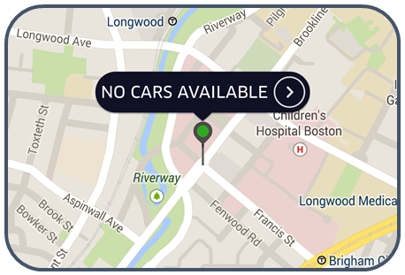


The Problem
Problem: vehicle imbalance in one-way systems
Demand for car sharing services shows temporal and spatial patterns. When users move to popular destinations, other areas remain without sufficient cars to serve demand. As a consequence, areas with low demand might have a lot of idle cars, while areas with high demand have none. This problem is known as vehicle imbalance.
If users experience continuous lack of available cars when trying to book the service, they switch to more reliable transportation services. Vehicle imbalance can bring thousands of euros in daily operating losses¹ to a car sharing business.
Solutions identified: vehicle relocation
With vehicle relocation, cars are physically moved from one location that has a vehicle surplus to another that experiences a vehicle shortage. Due to the evolving dynamics of service demand, if CSOs don’t update relocation strategies, costs increase without resolving vehicle imbalance ².
To solve vehicle imbalance and maximize profits in a car sharing system that employs relocation operations different mathematical models known as optimization frameworks or decision support systems (DSS) have been developed.
Research gap: demand forecast tool with high spatial and temporal resolution
The following quotes were taken from the European Journal of Operation Research and from the Transportation Research Journal:
“A central issue related to strategic decision-making for car-sharing systems is the estimation of the spatial and temporal
distribution of the demand” ³
“The operational management of carsharing systems
is complex due to the stochastic and dynamic nature
of demand in time and space” ⁴
“Stronger focus on reliable demand models which have not been covered comprehensively by literature in the past is needed” ⁵
(1) Jorge, D., Correia, G. H. A., and Barnhart, C. (2014). “Comparing optimal relocation operations with simulated relocation policies in one-way car sharing systems”. IEEE Transactions on Intelligent Transportation Systems, 15(4): 1667-1775.
(2) Kek, A. G. H., Cheu, R. L., and Chor, M. L. (2006). “Relocation simulation model for multiple-station shared-use vehicle system”. Transportation Research Record: Journal of the Transportation Research Board, 1986: 81-88.
(3) Boyaci, B., Zografos, K. G., Geroliminis N. (2014, pp. 735). “An optimization framework for the development of efficient one-way car-sharing systems”. European Journal of Operational Research, 240: 718-733.
(4) Boyaci, B., Zografos, K. G. and Geroliminis N. (2017, pp. 215). “An integrated optimization-simulation framework for vehicle and personnel relocations of electric carsharing systems with reservations”. Transportation Research Part B: Methodological, 95: 214-237.
(5) Weikl, S. (2016, pp. 30). “A Mesoscopic Relocation Model for Free-Floating Carsharing Systems”. Working paper. Institute for Transport and Regional Planning Department of Traffic Engineering, Munich.
Notes:
Research question: “Is it possible to develop a demand forecast model with high spatial and temporal resolution to be applied on a large-scale flexible car sharing system?”

Slide 50
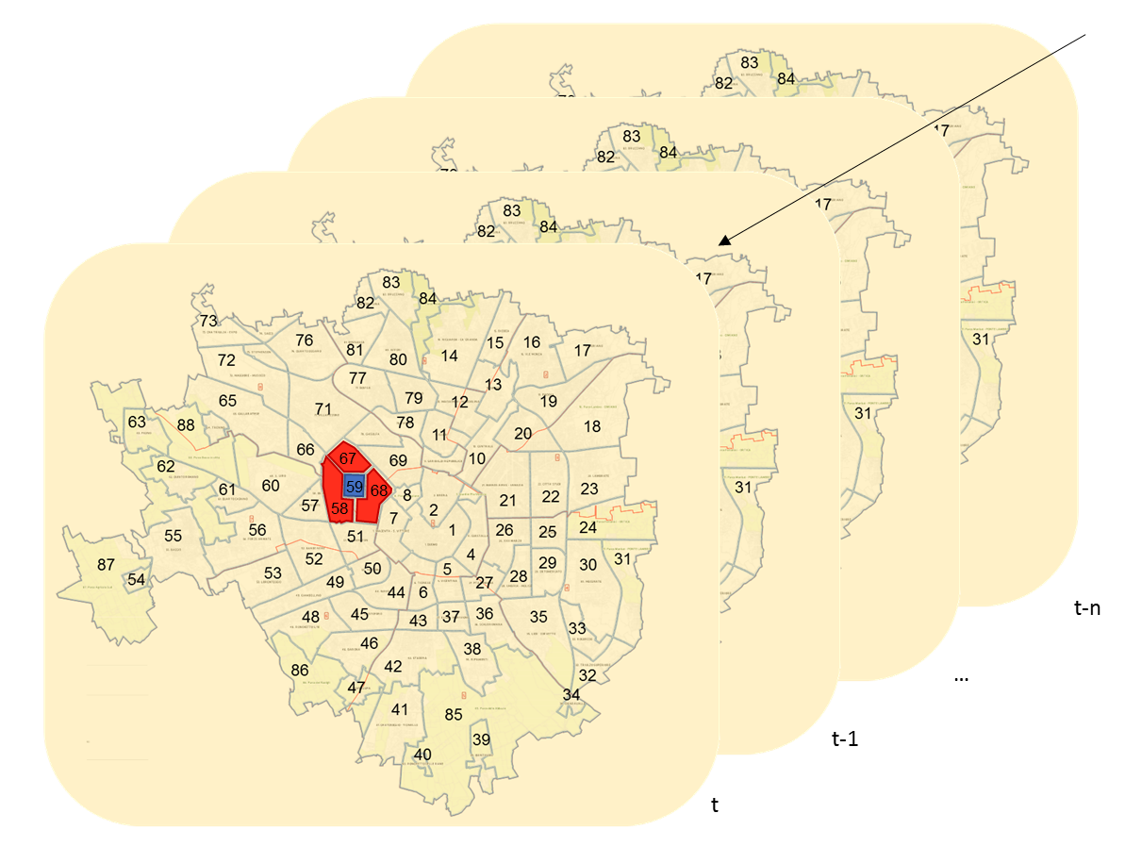
Objective: demand forecast in the city of Milan
Objective: forecast the demand (i.e. the total number of bookings) for a 1-hour period “t” in all the 86 areas of Milan in which car sharing services are available, using historical booking data (from “t-1” to “t-n”) of each area and its adjacent areas.
Figure 2: spatial and temporal division used for the analysis of car sharing demand
Dataset building. The original dataset contained a list of 810.000 rentals for all car sharing services in Milan, corresponding to all trips in the month of May 2017. For each rental, the following data was available: 1) origin and destination area; 2) origin and destination location coordinates; 3) time of origin and arrival; 4) duration time.
To create the final dataset, for each of the 86 areas in which car sharing services are available the 80 variables below were calculated for each one-hour period in the month of May 2017.
In particular, the following 40 variables were calculated both for the area considered and for the areas adjacent to the one considered: A) 24 variables representing the number of bookings in each of the previous 24 one-hour time periods; B) 7 variables representing the total number of bookings in the previous 24, 48, 72, 96, 120, 144 and 168 hours respectively; C) 7 variables representing the number of bookings in the same on-hour period in each of the previous 7 days; D) 2 variables representing the population of the area and the number of bookings in the considered one-hour period.
(1) The dataset didn’t include any information about CS users or the CSOs that provided the service. However, because the CSO’s financial performance and private information about users might be deducted from the data, the dataset is not sharable and the thesis cannot be published. Privacy matters were agreed by professor E. Borgonovo and Mr. E. Curto from Urbi for not sharing the dataset.

Slide 51
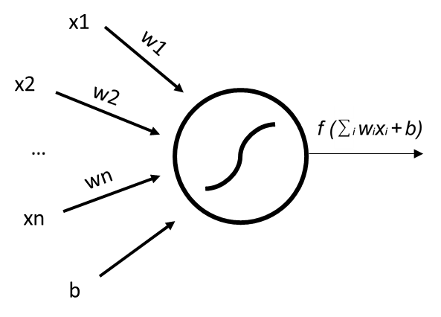
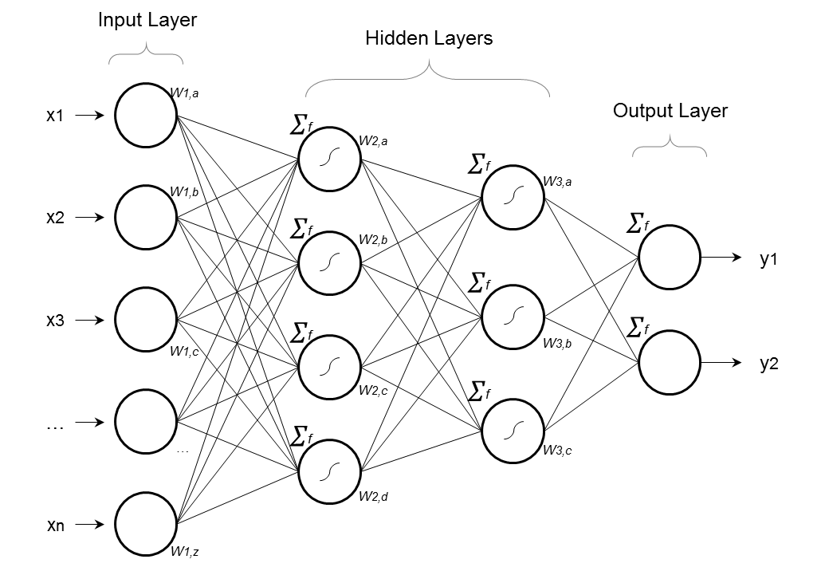
Method: Deep Neural Networks
Definition. Machine learning is an Artificial Intelligence (AI) discipline that aims to create algorithms that are capable of learning from various type of examples presented to them. One type of machine learning algorithms that had major success recently are Neural Networks¹ (NN), which consist in a series of interconnected layers formed by single units called neurons. Networks formed by hundreds of hidden layers are know as Deep Neural Networks, and the discipline that studies them is called Deep Learning.
Neurons. Each neuron is connected to the others in a series of synaptic connection that enable them to exchange information. From one layer to the other, neurons compute a weighted sum of their inputs and pass the result to the next layer. When the network tries to find relationships between the input and output layer, it modifies these weights to minimize the error, defined as the difference between the training data and the desired output ².
Figure 1: simple form of neural network
Backpropagation. During training, internal parameters adjust by themselves to minimize the error between the input variables and the output examples. This method, which enables feature extraction, is called backpropagation³. After extracting the features from the examples shown to it, the network is tested on a new set of data that was never shown to it in order to test his ability to predict (or categorize). This process is called validation.
Performance. If the error achieved during training and validation are sufficiently low, the model can be used in a real-case scenario. Deep Neural Networks (DNN) achieved incredible results in finding both linear and non-linear relationships in the vast sets of data in relatively little amounts of time without the need of creating complex mathematical models from scratch. They were able to resolve very complex problems with little need of human input ⁴.
(1) Bishop, C. M. (1995). “Neural networks for pattern recognition”. Clarendon Press, Oxford.
(2) LeCun, Y., Bengio, Y. and Hinton, G. (2015). “Deep learning”. Nature, 521: 436–444.
(3) Deng, L. and Yu, D. (2013). “Deep Learning Methods and Applications”. Foundations and Trends in Signal Processing, 7(3–4): 197–387.
(4) Bengio, Y. (2016). “Machines who learn”. Scientific American, 314: 46-51.

Slide 52
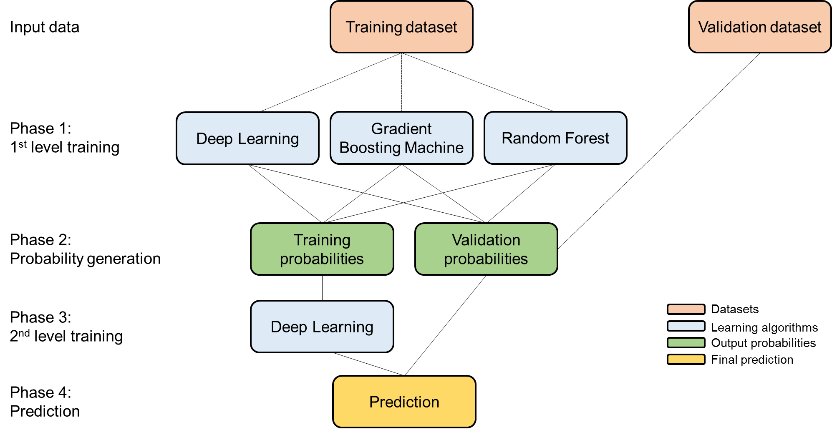
Deep Neural Network structure
An open-source software called H2O.ai was used to create the forecasting tool. The first DNN structure created achieved a root mean square error (RMSE) of 4,69 (cars/hour). To lower the error, stacking was implemented. Stacking ¹ allows to ensemble different machine learning algorithms. By implementing different learning techniques all at once, it is possible to achieve better performances compared to using one single learning method. The final forecasting tool achieved an RMSE of 4,04 (cars/hour). A visual representation of this final model is presented below.
(1) Deng, L. and Yu, D. (2013). “Deep Learning Methods and Applications”. Foundations and Trends in Signal Processing, 7(3–4): 197–387.

Slide 53
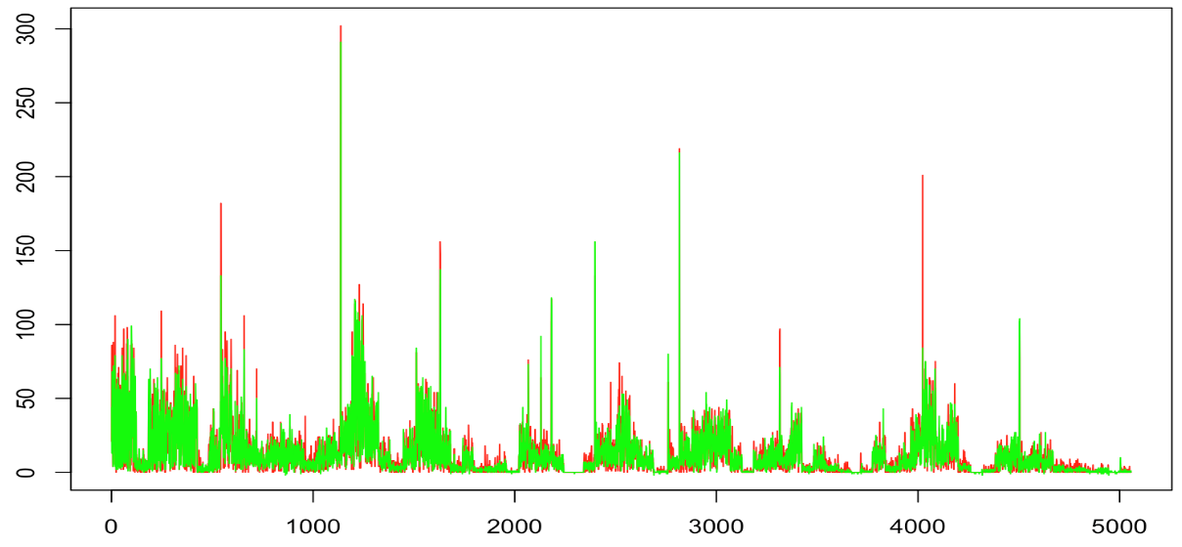
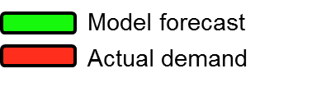
Deep Neural Network performance
The figure below compares the demand forecast of the tool with the actual demand for car sharing. It is evident that the DNN created performs remarkably well in forecasting the demand for car sharing. Still, the tool is not able to catch some peaks in the demand, which compromises its accuracy and therefore the possibility of using it on real car sharing operations. The reason behind these results is to be found in the relatively small amount of data available (1 month of car sharing trips in the city of Milan) not on the tool characteristics.
Bookings per-hour
Forecast number

Slide 54
Comparison with previous NN forecasting tools
The table below compares the DNN created with previous attempts to forecast the demand for car sharing using neural networks to clarify which model is best suited to be used on a large car sharing system. The characteristics of each model are compared and rated using a three-color scale. In particular, the following model characteristics are highly rated: a) developed analyzing a large car sharing system with a considerable number of average daily bookings; b) trained using a large dataset coming from a system that provides great flexibility to its users; c) high spatial and temporal resolution; d) deep not traditional neural network. Even if the RMSE of the tool created is higher compared to the ones of past models, its characteristics make it more suitable to be applied on a large-scale car sharing system.
Model | CS System dimension | Average trips per day | Data type | Data amount | Spatial resolution | Time resolution | Deep neural network | RMSE
Cheu et al., 2006 ¹ | 12 stations, 50 vehicles | 23 | One-way station-based | n.a. | Station | 3-hours | X | 2,58 trips/3-hours
Xu and Lim, 2007 ² | 13 stations, 82 vehicles | n.a. | One-way station-based | n.a. | Station | 1-hour | X | 2,4 trips/hour
Zhu et al., 2015 ³ | n.a. | n.a. | Taxi trips | 12000 trips | Area | 24-hours | V | 2,5 trips/day
Alfian et al., 2017 ⁴ | 10 stations, 100 cars | 100 | Round-trip | X | Station | 8-hours | X | 3,52 trips/8-hours
DNN tool created | All car sharing systems in Milan | 26132 | All types of CS systems | 810000 trips | Area | 1-hour | V | 4,04 vehicles/hour
(1) Cheu, R. L., Xu, J., Kek, A. G. H., Lim, W. P., and Chen, W. L. (2006). “Forecasting of shared-use vehicle trips using neural networks and support vector machines”. Transportation Research Record: Journal of the Transportation Research Board, 1968(5): 40-46.
(2) Xu, J. X. and Lim, J. S. (2007). “A New Evolutionary Neural Network for Forecasting Net Flow of a Car Sharing System”. Working paper. IEEE Congress on Evolutionary Computation (CEC).
(3) Zhu, X., Li, J., Liu, Z. and Yang, F. (2015). “Optimization approach to depot location in car sharing systems with big data”. Working paper. IEEE Congress on Big Data, Beijing.
(4) Alfian, G., Rhee, J., Ijaz, M. F., Syafrudin, M. and Fitriyani, N. L. (2017). “Performance Analysis of a Forecasting Relocation Model for One-Way Carsharing”. Applied Sciences, 7(6): 598.

Slide 55
GRAZIE Per LA VOSTRA Attenzione!

